Slide 1

World Happiness Report: 2015 & 2016
Marlene Aviles
Final Project
Data Exploration and Analysis

Slide 2

About World Happiness Report
The World Happiness Report is a landmark survey of the state of global happiness that ranks 156 countries by how happy their citizens perceive themselves to be. [1]
People in a survey were asked to rank the extent to which perception of the factors contributes to happiness scores.
The elements used include factors such as freedom, generosity, economy, and family.
The years and 2015 and 2016 were compared.

Slide 3


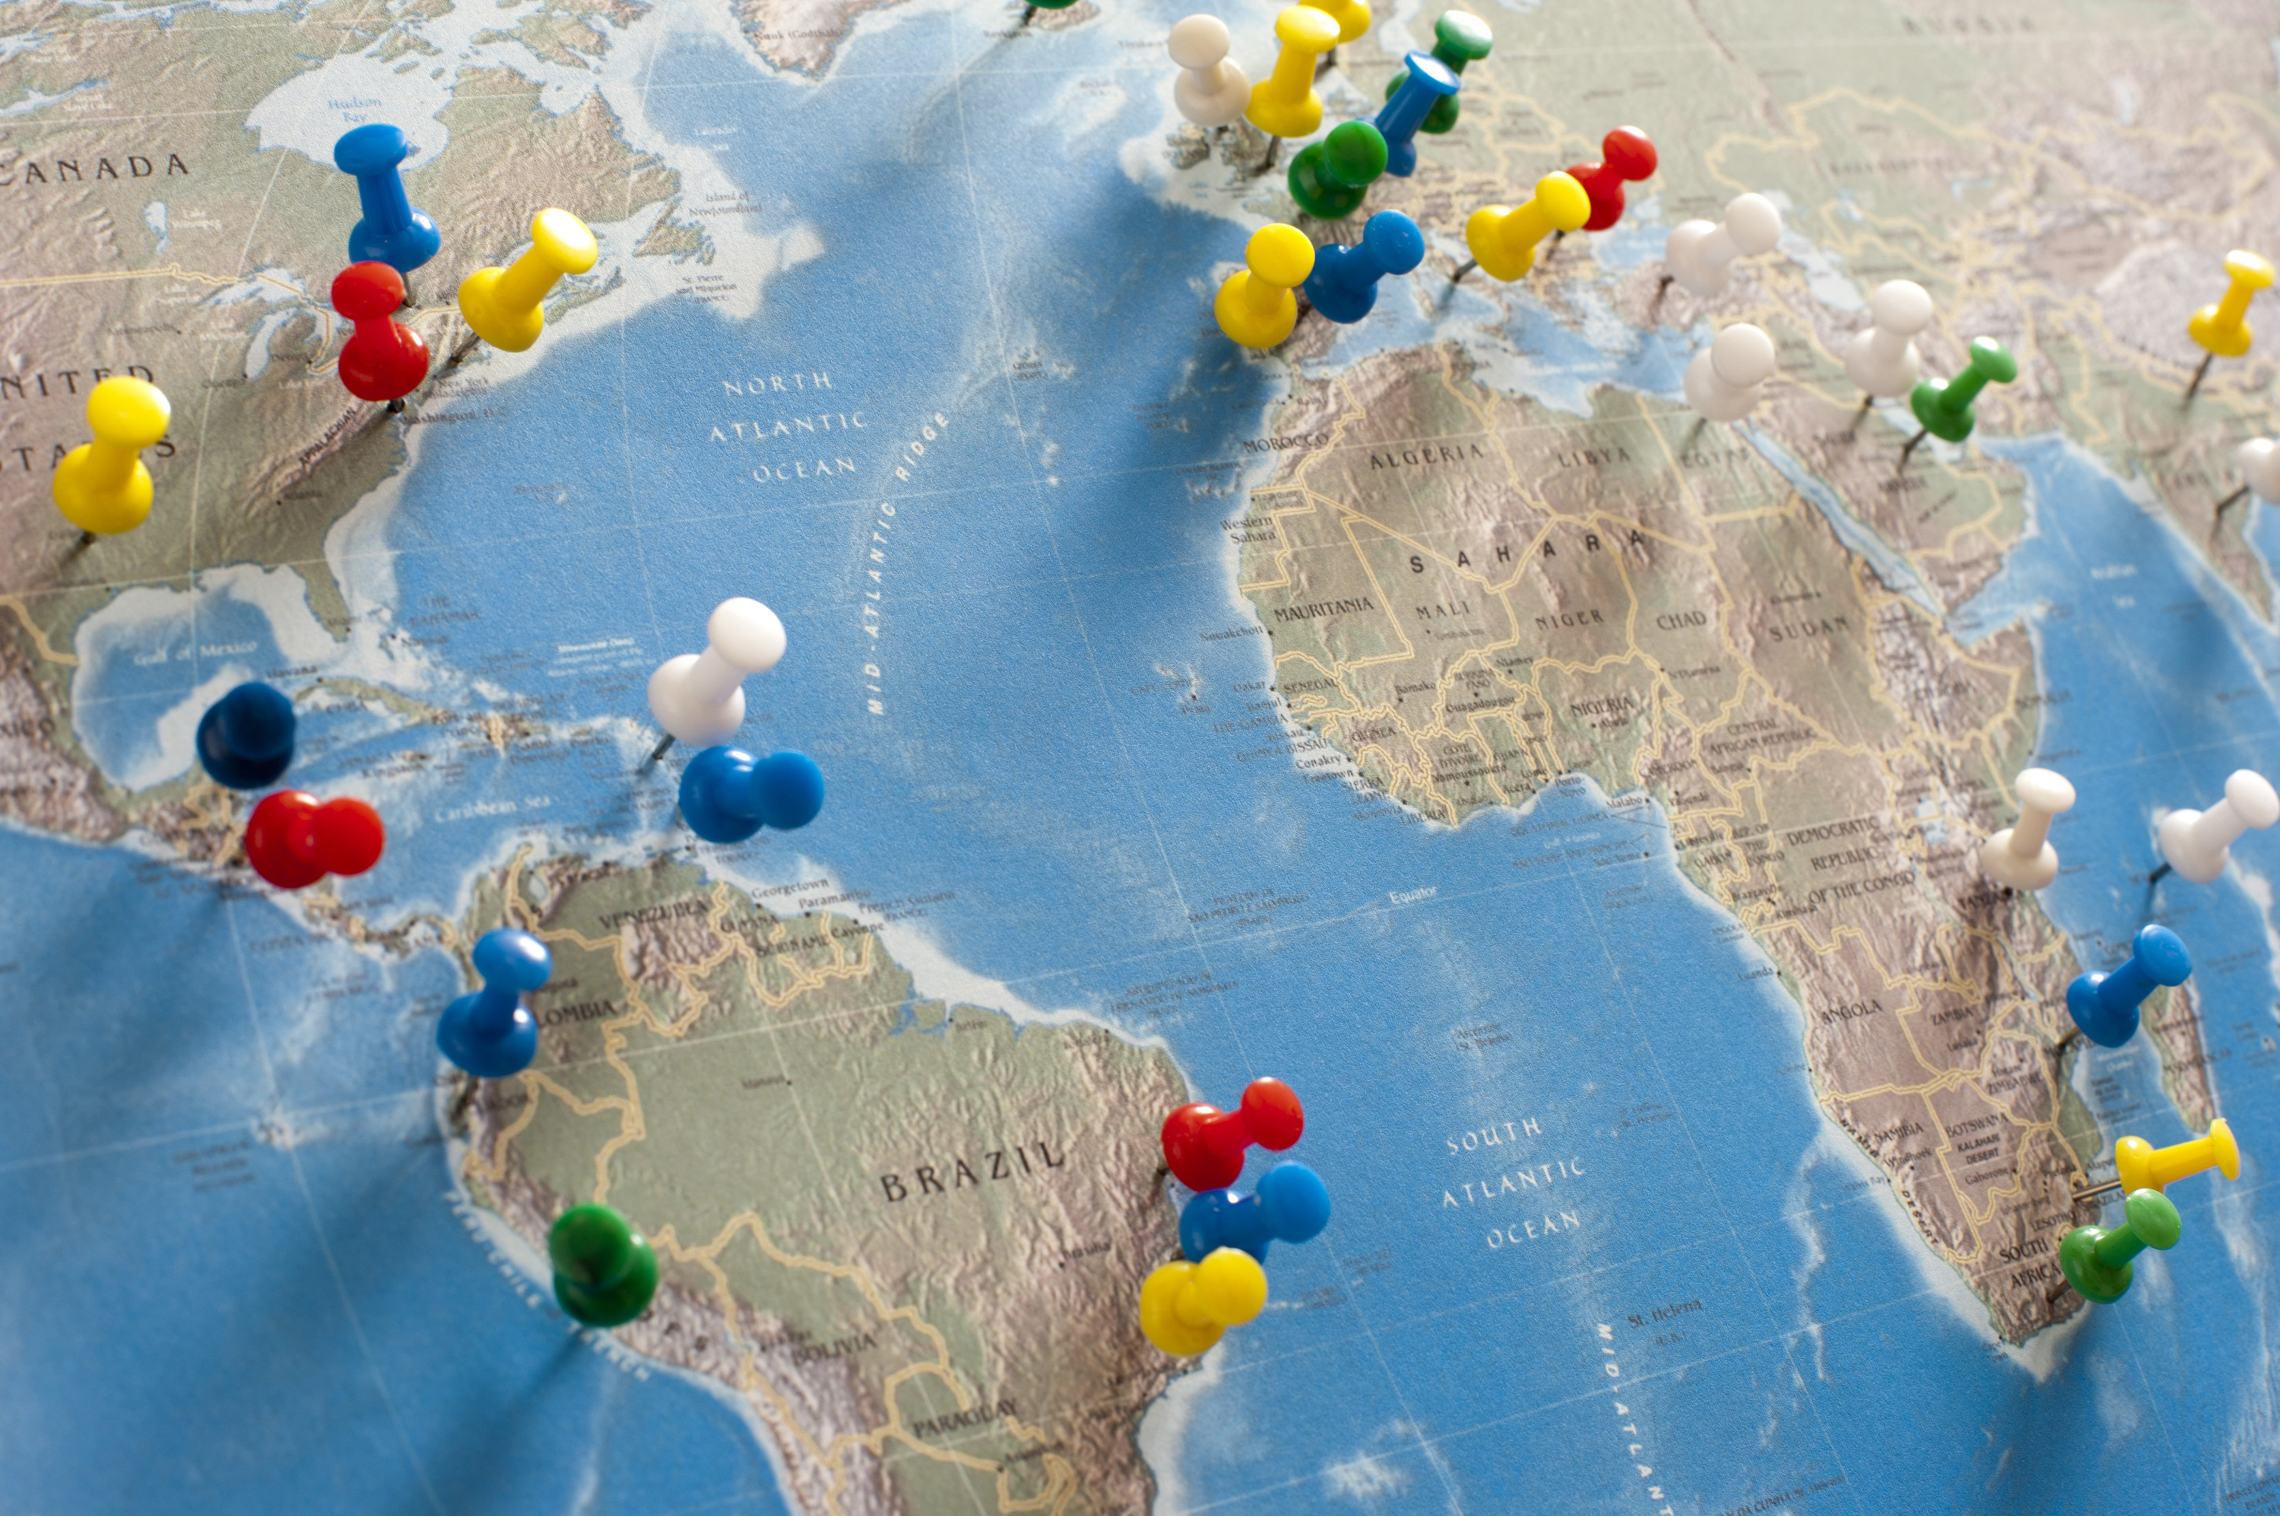
Variables
Country: Name of country
Region : Region the country pertains to
Happiness Rank : Rank of the country based on the Happiness Score
Happiness Score : A metric measured in 2015 by asking the sampled people: "How would you rate your happiness on a scale of 0 to 10 where 10 is the happiest.”
Lower Confidence Interval: the lower confidence limit of an estimate of a parameter *(2016 only)
Upper Confidence Interval: the upper confidence limit of an estimate of a parameter *(2016 only)
Economy (GDP per Capita): real GDP per capita
Family : social support
Health (Life Expectancy): healthy life expectancy
Freedom : freedom to make life choices
Trust (Government Corruption): perceptions of corruption
Generosity : perceptions of generosity
Dystopia : each country is compared against a hypothetical nation that represents the lowest national averages for each key variable and is, along with residual error, used as a regression benchmark
This Photo by Unknown Author is licensed under CC BY-SA
This Photo by Unknown Author is licensed under CC BY-SA-NC
This Photo by Unknown Author is licensed under CC BY

Slide 4

Hypothesis:
Regions with greater freedom to make individual life choices will tend to have a higher perception of happiness.

Slide 5

Analysis
To address the hypothesis, the datasets were analyzed using several Exploratory Data Analysis (EDA) methods.
Methods Applied:
Summary statistics analyzed (e.g. Mean, standard deviation, etc.)
Plots (histograms & scatterplots) were created for the variables analyzed
Probability Mass Function & Cumulative Distribution Function plotted
Correlation and correlation test applied
Regression analysis

Slide 6

Exploratory Data Analysis
Histograms
Scatter Plots
Regression Analysis

Slide 7
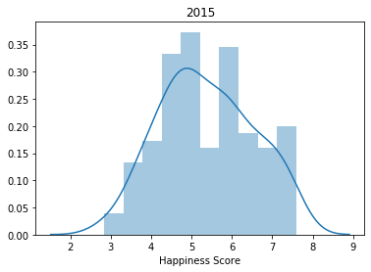
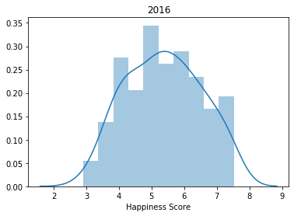
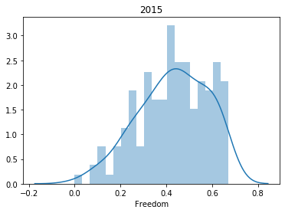
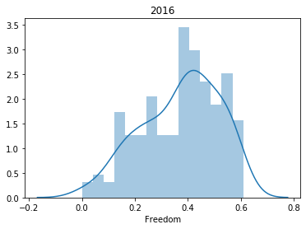
Histograms of Happiness Score & Freedom

Slide 8
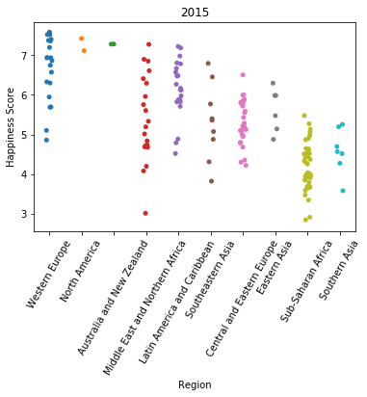
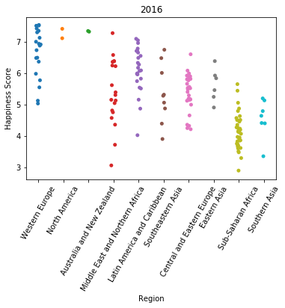
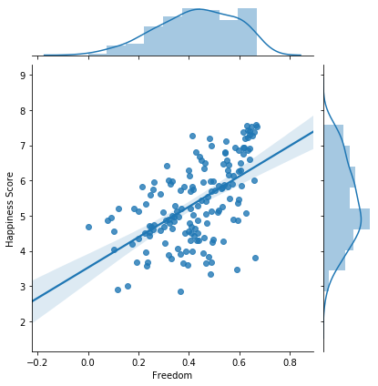
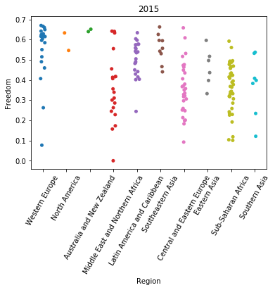
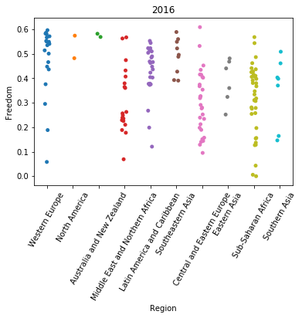
Scatter Plots & Regression Analysis

Slide 9
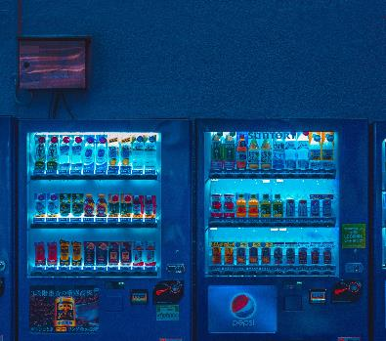


Results
Although it was noted that freedom does have a positive correlation, other factors were found to have a more significant impact on the happiness score.
Pearson's correlation was measured, and the top three variables with the highest correlation to happiness scores in the years 2015 and 2016 were found to be economy, family, and health.
Regression analysis was applied to the 2015 dataset. This analysis was conducted on the happiness scores with freedom as a predictor, EDA showed a positive linear relationship.
It was also noted that the scatter plots support that regions with the highest sense of freedom tend to have a higher happiness score, as reflected in the data collected from western Europe. The mean score for both years remained consistent at a 5.38. On the other hand, the sense of freedom did decrease from 0.43 in 2015 to 0.37 in the year 2016.

Slide 10
Observations
What do you feel was missed during the analysis?
Additional demographic information, such as the socio-economic status of those individuals surveyed, could have been included in this analysis to provide a better understanding to see if their current situation has any weight on the selection of the scores.
Were there any variables you felt could have helped in the analysis?
The inclusion of a variable that measures the relationship between a person's work environment and their happiness score could assist this analysis.
Were there any assumptions made you felt were incorrect?
It was assumed that the level of sense of freedom a person has would have the most significant effect on their happiness score.

Slide 11

Sources Cited
1. Gallup (n.d.) Tracking the World's Happiness.
Retrieved from https://www.gallup.com/analytics/247355/gallup-world-happiness-report.aspx
2. United Nations Sustainable Development Solutions Network. (2017). World Happiness Report. [Data file]. Retrieved from https://www.kaggle.com/unsdsn/world-happiness

Slide 12


Thank You
Marlene Aviles
Maviles@my365.bellevue.edu

